Slide 1

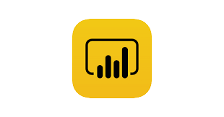


Spotify User Behaviour Analysis
HOME
TABLE OF CONTENTS
INCLUDES
01
Introduction
02
Approach
03
Result
04
Recommendations
An end-to-end project includes data analysis, machine learning model building, and recommendation
THANKS!
Tool Used

Slide 2
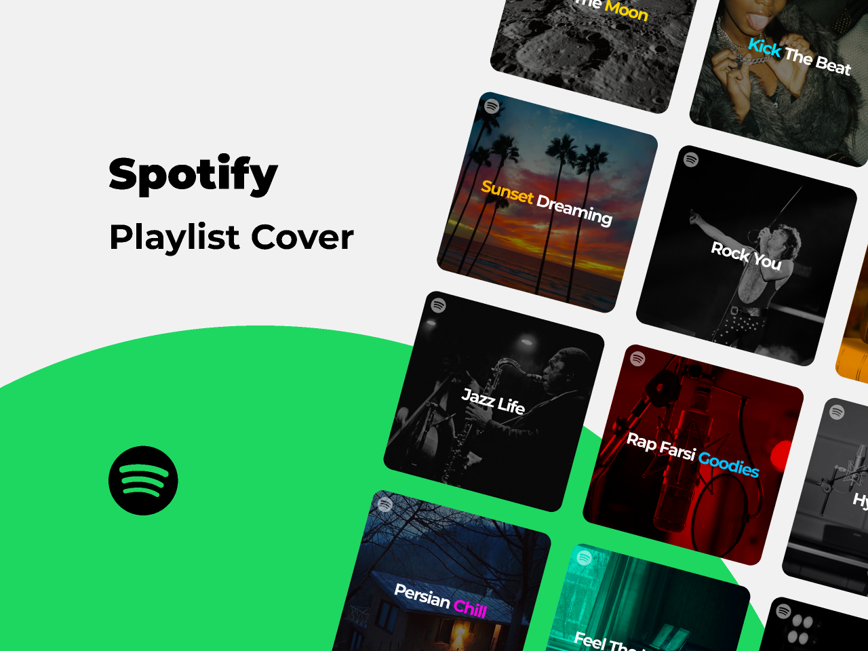
HOME
TABLE OF CONTENTS
PLAYLIST
01
Aashayein
02
Yeh Dil Deewana
03
Tu Hi Meri Shab Hai
Spotify is a leading music streaming service offering a vast collection of songs, albums, and podcasts.
Users can access music from various genres, create playlists, receive personalized recommendations, and enjoy both free and premium subscription options for an immersive audio entertainment experience.
04
Khuda Jaane
THANKS!

Slide 3
Presentation contents
Introduction
Approach
01
02
Results
Recommendations
03
04
HOME
TABLE OF CONTENTS
INCLUDES
Introduction
01
Approach
Services that allows user to stream music in demand
Exploratory data analysis, Statistical analyisi and machine learnings.
02
03
Results
04
Recommen-dation
Insights from the analysis drive solution
Recommendation are made through analysis of given data
THANKS!

Slide 4
01
Introduction
HOME
TABLE OF CONTENTS
INCLUDES
Introduction
01
02
Approach
03
Results
04
Recommen-dation
Spotify user behavior data analysis
THANKS!

Slide 5
HOME
PROJECT CONTENTS
INCLUDES
Topic
In this presentation, I will be discussing the results of my analysis of the Spotify user behavior and preferences dataset.
Dataset
The dataset contains information about Spotify users' age, gender, listening habits, and preferences etc.
01
Topic
02
Dataset
03
Research Questions
04
Approach
THANKS!

Slide 6
HOME
TABLE OF CONTENTS
Research questions
I am trying to answer the following research questions:
What are the factors that are most likely to lead to churn?
What are the different types of users who use Spotify?
How do users discover new music?
What are the most popular genres of music and podcasts on Spotify?
How satisfied are users with Spotify's services?
What are the most important features for improving Spotify's user experience?
Approach
I used a variety of data analysis techniques to answer these research questions, including exploratory data analysis, statistical analysis, and machine learning.
INCLUDES
01
Topic
02
Dataset
03
Research Questions
04
Approach
THANKS!

Slide 7
02
Approach
HOME
TABLE OF CONTENTS
INCLUDES
Introduction
01
02
Approach
03
Results
04
Recommen-dation
Spotify user behavior data analysis
THANKS!

Slide 8
Data Preprocssing
Exploratory Analysis
HOME
TABLE OF CONTENTS
APPROACH
01
Data Preprocessing
02
Exploratory data analyisis
I first removed any missing values from the dataset and encoded the categorical variables.
I then conducted exploratory data analysis to get a better understanding of the data. This included looking at the distribution of the data, finding relationships between different variables, and identifying any patterns or trends.
03
Statistic Analysis
04
Machine learning
THANKS!

Slide 9
Statistical Analysis
Machine learning
HOME
TABLE OF CONTENTS
APPROACH
01
Data Preprocessing
02
Exploratory data analyisis
I I conducted statistical analysis to assess particular hypotheses regarding the data. For instance, I employed correlation coefficients to comprehend the relationships.
I also used machine learning to build random forest models that can predict willingness to buys premium subscription or other user behaviors
03
Statistical Analysis
04
Machine learning
THANKS!

Slide 10
03
Results
HOME
TABLE OF CONTENTS
INCLUDES
Introduction
01
02
Approach
03
Results
04
Recommen-dation
Spotify user behavior data analysis
THANKS!

Slide 11
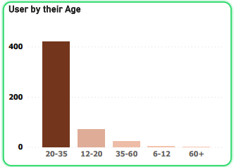
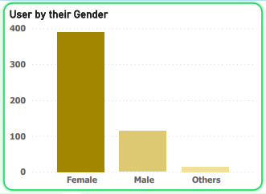
HOME
TABLE OF CONTENTS
RESULTS
Age Distribution
The majority of Spotify users are in the 20-35 age range.
Spotify is popular among young adults.
01
Age Distribution
02
Gender Distribution
03
User by subscrioption
Gender Distribution
The majority of Spotify users are in Female.
Female users are more likely to be willing to subscribe to Spotify Premium than male users
04
Premium subscription willingness
THANKS!

Slide 12
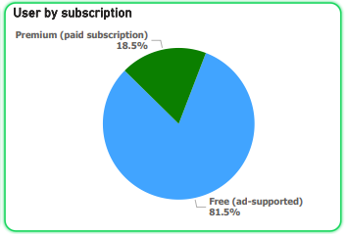
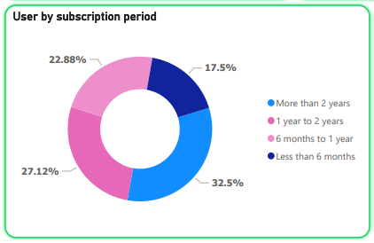
HOME
TABLE OF CONTENTS
RESULTS
User by subscription
The majority of Spotify users are on the free tier.
Spotify is still need to convert more users to premium subscriptions.
01
Age Distribution
02
Gender Distribution
03
User by subscrioption
User by subscription period
The majority of Spotify users have been using the service for one and more than 2 years.
Spotify is still a relatively new service, and that it is growing rapidly.
04
User by subscription period
THANKS!

Slide 13
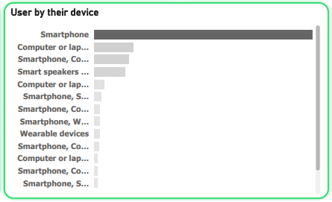
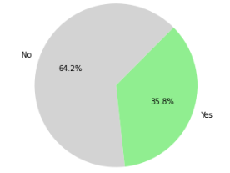
HOME
TABLE OF CONTENTS
Most popular listening device
The most popular listening device for Spotify users is the smartphone.
Spotify is a very mobile-friendly service.
RESULTS
05
Device
06
Premium subscription willingness
07
User satisfaction
Willingness to buy subscription plan
The majority of Spotify users are not willing to pay for a premium subscription.
Spotify need to increase conversion rate for generate a lot of revenue from premium subscriptions.
08
Preferred premium plan
THANKS!

Slide 14
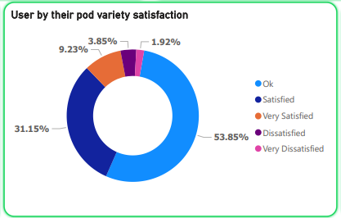
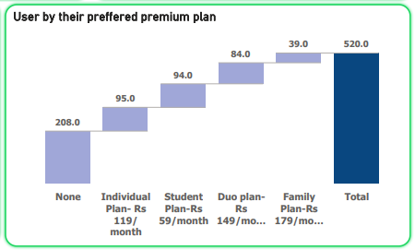
HOME
TABLE OF CONTENTS
User satisfaction
The majority of Spotify users are ok with service and satisfied with Spotify's music recommendations.
users are finding the music they want to listen to but needs to be covert into satisfied user
RESULTS
05
Device
06
Premium subscription willingness
07
User satisfaction
Preferred premium plans
The majority of Spotify users does not have premium subscription.
The most popular premium plan is the Individual Plan and student. most of Spotify users are only interested in subscribing for themselves..
08
Preferred premium plan
THANKS!

Slide 15
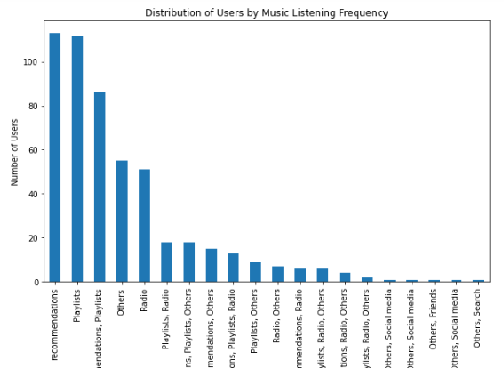
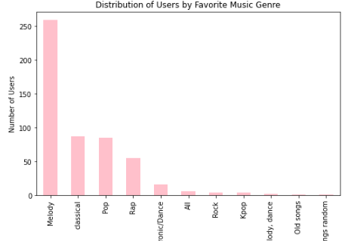
HOME
TABLE OF CONTENTS
New music discovery
The most popular method for discovering new music on Spotify is through the playlist and recommendation.
Spotify's algorithmic recommendations are very effective.
RESULTS
09
New music discovery
10
Popular genres
11
Time slot
Popular genres
more than 50% of user love to listening the melody songs
The most popular music genres on Spotify are melody, classical, pop and rap. Spotify users have a wide range of musical tastes.
12
Listening content
THANKS!

Slide 16
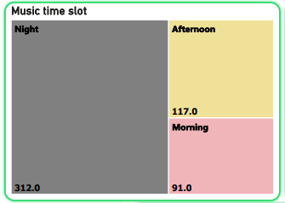
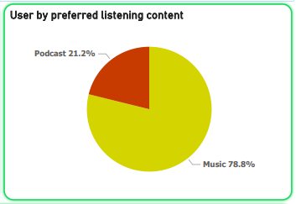
HOME
TABLE OF CONTENTS
Music time slot
The most popular time slot for listening to music is night.
Spotify users use the service to relax and unwind after a long day.
RESULTS
09
New music discovery
10
Popular genres
11
Time slot
Listening content
More than 70% of user love to listening the music.
The majority of Spotify users prefer to listen to music. Spotify is primarily a music streaming service.
12
Listening content
THANKS!

Slide 17
04
Recommendations
HOME
TABLE OF CONTENTS
INCLUDES
Introduction
01
02
Approach
03
Results
04
Recommen-dation
Spotify user behavior data analysis
THANKS!

Slide 18
Digital Marketing
HOME
TABLE OF CONTENTS
Target female users for Spotify Premium to boost subscription rates and revenue.
Create marketing campaigns that appeal to female interests, such as music, fashion, and beauty.
RECOMMENDATION
01
Digital marketing
02
Loyalty
programms
03
Target mobile listeners
Implement a loyalty program by offering discounts to long-term Spotify users.
This approach can increase customer lifetime value and strengthen the user base while promoting sustained revenue growth.
Trial period
Loyalty Programme
04
THANKS!

Slide 19
Target mobile listeners
HOME
TABLE OF CONTENTS
Promote Spotify strategically to mobile-centric users, capitalizing on their behavior for better engagement, subscriptions, and revenue growth by optimizing the mobile trend's potential.
RECOMMENDATION
01
Digital marketing
02
Loyalty
programms
03
Target mobile listeners
Offer a free Spotify Premium trial, allowing users to experience benefits, potentially leading to subscriptions.
This boosts engagement, lowers entry barriers, and drives revenue.
Trial period
Loyalty Programme
04
THANKS!

Slide 20
Personalized Music
HOME
TABLE OF CONTENTS
Create varied playlists across genres. Offer personalized music based on listening history, satisfying users.
Tailored suggestions boost engagement, time on platform, and potential Premium sign-ups, driving loyalty and revenue.
RECOMMENDATION
05
Personalized music
06
Accurate music
07
Expand music and podcast
Ensure music suggestions are precise and pertinent, enhancing user experience.
Guarantee accuracy in recommending music choices that resonate, contributing to user satisfaction and engagement.
Accurate music
User friendly
08
THANKS!

Slide 21
Expand music and podcast
HOME
TABLE OF CONTENTS
Diversify podcast offerings with trending and popular shows.
Enrich the selection to incorporate in-demand content, catering to broader interests and enhancing user engagement.
RECOMMENDATION
05
Personalized music
06
Accurate music
07
Expand music and podcast
Optimize Spotify for maximum user-friendliness and enjoyment.
Strive to create an experience that is intuitive and pleasurable, ensuring users find navigating and using the platform effortless and delightful.
User friendly
User friendly
08
THANKS!

Slide 22

Thank You

